Slide 1

Final Report
Business Modalities for Implementation of Solar Power Project by CIL in Rajasthan
Oct 2022

Slide 2
CONTENTS
Slide No.
 | Background | 3
 | Power Sale Modalities | 6
 | Construction Modalities | 42
 | O&M Modalities | 45
 | Evaluation of JV Option | 47
 | Financial Scenario Analysis | 51
 | Summary and Key Takeaways | 55
 | Annexures | 60
1
2
3
4
5
6
7
8

Slide 3
Background
Coal India Ltd (CIL) has set a target of establishing 3 GW of Solar Power generating capacity by 2024
Rajasthan Rajya Vidyut Utpadan Nigam Ltd (RVUNL), the state-owned power generation utility in Rajasthan, is in the process of establishing a 2000 MW solar park in Bikaner district in Rajasthan
With respect to 1,190 MW out of the total 2GW solar park capacity, RVUNL had expressed willingness to obtain CIL’s support in establishing solar power plant
Subsequently, MoU was signed between CIL and RVUNL on 13th Oct 2022 for setting up of solar power plant(s) of 1,190 MW capacity at RVUNL’s solar park
With respect to balance 810 MW, RVUNL had originally intended to execute the same through TBCB route u/s 63, however it has been facing challenges in the same (deviation from SBD TBCB guidelines in terms of project execution timelines)
Thus, as on date, RVUNL is contemplating to execute the 810 MW capacity through EPC tendering route and has expressed its intent to form a Joint Venture Company with CIL to develop the solar park as Solar Park Developers, wherein CIL would additionally execute the solar project through EPC tendering
CIL made multiple visits to RVUNL’s HQ (21st–23rd July’22 , 2nd Sept’22, 10-11th Nov ’22 and 14th–15th Dec ‘22 to obtain insights about RVUNL’s plan, ground-progress for the solar park development and to discuss on the possible options for sale of solar power. CIL also visited the proposed site at Bikaner on 23rd Jul ‘22

Slide 4
Key Aspects Covered
1
2
3
4
5
Power Sale Options
Construction Modalities
O&M Modalities
Evaluation of JV Option
Financial Scenario Analysis
Notes:
Vanya Aug 5

Slide 5
Power Sale Modalities

Slide 6
Options for sale of Solar Power by CIL (1/4)
Options for sale of solar power by CIL
A. Sale to Commercial Consumers
B. Captive Consumption
1. Sale to RVUNL
2. Sale to Rajasthan DISCOMs u/s 62
3. Sale u/s 63
4. Other Sale options
3.A. Sale within Rajasthan through TBCB route
3.B. Sale outside Rajasthan through TBCB route
3.C. Sale under CPSU scheme
4.A. Sale to Open Access (C&I*) Consumers
4.B. Sale through Trading Licensees
4.C. Sale through Power Exchange
1.A Bundling mechanism w.r.t RVUNL’s existing TPPs
1.A1 Bundling mechanism w.r.t RVUNL’s upcoming TPPs
1.B Meeting Aux Power Consumption (APC) requirement of the TPPs under RVUNL
* Commercial and Industrial

Slide 7
1. Sale to RVUNL

Slide 8
1.A. Sale to RVUNL under MoP’s bundling mechanism with the existing TPPs of RVUNL
Procurement of RE power by existing Thermal Genco(s) through
co-located power plants (direct purchase u/s 62) ; or
separately located plants (through competitive bidding)
Procured RE power is bundled with Thermal generation keeping overall PPA commitment constant
What is Bundling?
Reduces the power purchase cost by bundling the costly thermal/hydro power with cheaper RE power
Procured RE power to be counted towards RPO compliance of the DISCOM
Benefits
In case RE power plant is co-located with the TPP, then the RE project is to be developed through EPC tendering and the power tariff shall be determined by respective SERC; in case the RE project is not co-located, the RE procurement should be on competitive basis
Considering RVUNL’s plan to set up for 810 MW solar plant on its own and low PLF of the existing TPPs of RVUNL, potential opportunity for offtake of any additional solar power by RVUNL for bundling seems limited
Challenges
Since CIL’s proposed RE project in Rajasthan will “not” be co-located with RVUNL’s TPPs, therefore an exemption from the above provision will be necessary.
This bundling scheme would be beneficial for RVUNL if CIL’s solar tariff < Energy Charge Rate (ECR) of RVUNL TPPs
Key Considerations for CIL
Annexure 2: Clause for location criteria under MoP RE Bundling Scheme
Annexure 3: Average ECR of RVUNL TPPs of past 6 months

Slide 9
1.A1. Sale to RVUNL under MoP’s bundling mechanism with the upcoming TPPs of RVUNL
Background
RVUNL has informed that it has around ~2,310 MW of untied/ unexecuted thermal PPA.
As per discussion, the plants with respect to the above capacity are currently in planning stage.
Further, as per MoP Circular (F. No. 09/11/2021-RCM) dated 26th May 2022, the Ministry had provided the trajectory for replacement of Thermal Energy with Renewable Energy under Bundling Scheme; wherein all CPSUs, State and Private Generation Utilities have been asked to take appropriate action in order to meet the trajectory targets viz. 20% in 2023-24, 35% in 2024-25 and 45% in 2025-26 of the total target, ie 58,000 MUs.
Discussions in this regard have been carried out with RVUNL for possible bundling of RE power from solar projects set up by CIL with these upcoming thermal plants of RVUNL.
Key Considerations for CIL:
With respect to this scheme, since the thermal and RE plants would not be co-located, necessary exemption would have to be sought from the appropriate authorities for carrying out solar project wherein tariff would have to be determined u/s 62
Further, it should be noted that the thermal plants are still in planning stage and thus a gestation period of 4-5 years can be expected at the least, during which no solar generation can be dispatched
Additionally, it should also be noted that this scheme will be financially viable only if the solar tariff is less than the Energy Charge Rate of the thermal plants
Note: Further, discussion with RVUNL had taken place for possible replacement of ~990 MW of unexecuted gas PPAs of RVUNL with solar generation. Same was subsequently proposed by RVUNL to Rajasthan Urja Vikas Nigam Ltd.; however, the proposal was rejected

Slide 10
1.B. Sale of Solar Power to meet Auxiliary Power requirement of RVUNL TPPs
SCENARIO-1: ORIGINAL CASE (ILLUSTRATIVE)
SCENARIO-2: MEETING AUX POWER THROUGH SOLAR (ILLUSTRATIVE)
Overall auxiliary consumption for RVUNL Coal TPPs: ∼670 MW
To Discom
To Discom
Solar PP
Energy Charge payment by Discom to TPP
= ECR (Rs/kWh) x 90 MU
Energy Charge payment by Discom to TPP
= ECR (Rs/kWh) x 100 MU
Net Gen = 90 MU
Net Gen = 100 MU
Solar Generation = (10 MU + STU loss)
Plant-wise Auxiliary consumption details are provided in Annexure 4
Auxiliary Consumption = 10 MU
Gross Gen = 100 MU
Gross Gen = 100 MU
STU loss
Key Considerations for CIL
TPP
TPP
There is no regulatory provision for such arrangement
Suitable Policy Advocacy needs to be carried out at Rajasthan Energy Ministry and Regulator levels to address the above matter
Payment for Solar Power by TPP to Solar Developer
= Solar Tariff (Rs/kWh) x (10 MU + line loss)
Auxiliary Consumption = 10 MU
Auxiliary Load
Auxiliary Load
Electricity flow
Payment of STU & SLDC Charges for procurement of RE power from PoD
Payment
Figures above are illustrative and for explanation purpose

Slide 11
2. Sale to Rajasthan DISCOMs u/s 62

Slide 12
2. Sale of Solar Power to Rajasthan DISCOMs under Section 62 of EA 2003
Section 62 of Electricity Act 2003, provides for sale of power directly to DISCOMs without going into competitive bidding. The concerned Electricity Regulatory Commission (RERC in this case) will determine the tariff for such sale of power by Genco to DISCOM
Regulatory requirements for determination of solar tariff under Section 62 as per the ‘Rajasthan Electricity Regulatory Commission (Terms and Conditions for Tariff determination from Renewable Energy Sources) Regulations, 2020’:
RERC can determine project-specific tariff on case-to-case basis for new Solar PV Projects.
The Developer needs to submit a petition including:
Filled-in formats as per Regulations,
Project DPR,
Consent from Distribution Licensee in form of initialled PPA
Rationale for opting project specific tariff instead of competitive bidding and Competitiveness of the proposed tariff vis-à-vis tariff discovered through Competitive Bidding/tariff prevalent in the market.
Relevant clause from RERC (Terms and Conditions for Tariff determination from Renewable Energy Sources) Regulations, 2020 is reproduced in Annexure 5
Key Consideration for CIL:
For sale of power to DISCOM u/s 62, tariff needs to be comparable with prevalent tariffs discovered through competitive bidding
As per current trend, Rajasthan Discoms will potentially remain solar RPO surplus in near future, which may pose challenge for further sale of solar power to Rajasthan DISCOM u/s 62
Details of solar tariffs discovered in recently concluded IPP tenders are provided in Annexure 6
RPO projection for Rajasthan DISCOMs is provided in Annexure 7

Slide 13
3.A. Sale within Rajasthan u/s 63

Slide 14
3.A. Sale within Rajasthan through TBCB route u/s 63 (1/3)
Sale of Power will be to Rajasthan DISCOMs where tariff is discovered u/s 63.
Historically, SECI has floated four tenders in this regard of cumulative ~4.3 GW capacity; results of which are provided below for reference
SECI RAJASTHAN 750 MW TRANCHE I
e-RA date: 01st Mar 2019
Bidder's Name | Tariff (INR/kWh) | Awarded capacity (MW)
Fortum Solar Plus Private Limited | 2.48 | 250
Palimarwar Solar House Private Limited | 2.48 | 40
ACME Solar Holdings Limited | 2.48 | 250
Sitara Solar Energy Private Limited | 2.48 | 100
Renew Solar Power Private Limited | 2.49 | 110
TOTAL CAPACITY AWARDED |  | 750

Slide 15
3.A. Sale within Rajasthan through TBCB route u/s 63 (2/3)
SECI RAJASTHAN 750 MW TRANCHE II
e-RA date: 19th Jun 2019
Bidder's Name | Tariff (INR/kWh) | Awarded capacity (MW)
NTPC Ltd. | 2.50 | 160
Mahindra Susten Pvt. Ltd. | 2.50 | 200
Hero Solar Energy Pvt. Ltd | 2.50 | 250
Azure Power | 2.50 | 70
TOTAL CAPACITY AWARDED |  | 680
SECI RAJASTHAN 1070 MW TRANCHE III
e-RA date: 23rd Nov 2020
Bidder's Name | Tariff (INR/kWh) | Awarded capacity (MW)
Aljomaih Energy and Water Co. | 2.00 | 200
Green Infra Wind Energy Limited | 2.00 | 400
NTPC Limited | 2.01 | 670
TOTAL CAPACITY AWARDED |  | 1,070

Slide 16
3.A. Sale within Rajasthan through TBCB route u/s 63 (3/3)
SECI RAJASTHAN 1785 MW TRANCHE IV
e-RA date: 24th Dec 2021
Bidder's Name | Tariff (INR/kWh) | Awarded capacity (MW)
Calpine Subsico Solar Energy Pvt Ltd | 2.17 | 90
NTPC Renewable Energy Limited | 2.17 | 500
Sprng Natural Power Source Private Limited | 2.17 | 200
Metka Egn Singapore Holdings 3 Pte. Ltd. | 2.17 | 20
ReNew Solar Power Private Limited | 2.18 | 600
ACME Solar Holdings Private Limited | 2.18 | 375
TOTAL CAPACITY AWARDED |  | 1,785
Way Forward for CIL
Liaising with SECI to understand timelines for floating future Rajasthan specific solar tenders
Liaising with RUVNL/ Rajasthan DISCOMs to understand their plans / appetite for solar procurement
Historically, tariffs discovered have been low, and hence possible avenues for tariff optimization need to be explored

Slide 17
3.B. Sale outside Rajasthan u/s 63

Slide 18
3.B. Sale outside Rajasthan through TBCB route u/s 63 (1/4)
Participation in tender(s) wherein sale of power will be to states outside Rajasthan through tariff discovered through competitive bidding (TBCB) under Section 63
Results of solar TBCB tenders in 2022 so far provided below for further reference
SECI KARNATAKA (KOPPAL S/S) ISTS 1200 MW TRANCHE X
e-RA date: 02nd Feb 2022
Bidder's Name | Tariff (INR/kWh) | Awarded capacity (MW)
Project Eight Renewable Power Private Limited (Ayana) | 2.36 | 300
Solar One Energy Private Limited (Fortum) | 2.37 | 300
TOTAL CAPACITY AWARDED |  | 600
SECI KARNATAKA (GADAG S/S) ISTS 1200 MW TRANCHE X
e-RA date: 04th Feb 2022
Bidder's Name | Tariff (INR/kWh) | Awarded capacity (MW)
Project Eight Renewable Power Private Limited (Ayana) | 2.35 | 300
Solar One Energy Private Limited (Fortum) | 2.36 | 300
TOTAL CAPACITY AWARDED |  | 600

Slide 19
3.B. Sale within Rajasthan through TBCB route u/s 63 (2/4)
GUVNL 500 MW PHASE XIII
e-RA date: 16th Mar 2022
Bidder's Name | Tariff (INR/kWh) | Awarded capacity (MW)
SJVN Ltd. | 2.29 | 100
Solar XL Alpha Energy Pvt. Ltd (Fortum) | 2.29 | 200
Amsa Solar Energy Pvt. Ltd. (UPC Solar) | 2.29 | 80
Hinduja Renewables | 2.29 | 120
TOTAL CAPACITY AWARDED |  | 500
GUVNL 500 MW PHASE XIV
e-RA date: 10th Jun 2022
Bidder's Name | Tariff (INR/kWh) | Awarded capacity (MW)
ABREL SPV 2 Ltd. | 2.30 | 300
Hinduja Renewables | 2.30 | 120
SJVN Ltd. | 2.31 | 80
TOTAL CAPACITY AWARDED |  | 500

Slide 20
3.B. Sale within Rajasthan through TBCB route u/s 63 (3/4)
MSEDCL 500 MW PHASE VII
e-RA date: 4th Aug 2022
Bidder's Name | Tariff (INR/kWh) | Awarded capacity (MW)
SJVN Green Energy Ltd. | 2.90 | 200
Juniper Green Energy Pvt. Ltd. | 2.90 | 75
Tata Power Renewable Energy Ltd | 2.91 | 150
SAEL Ltd. | 2.91 | 50
Avaada | 2.91 | 25 (out of quoted 300)
TOTAL CAPACITY AWARDED |  | 500
MSEDCL 500 MW PHASE VIII
e-RA date: 7th Sep 2022
Bidder's Name | Tariff (INR/kWh) | Awarded capacity (MW)
NTPC Renewable Energy | 2.82 | 200
Avaada | 2.83 | 300 (out of quoted 500)
TOTAL CAPACITY AWARDED |  | 500

Slide 21
3.B. Sale within Rajasthan through TBCB route u/s 63 (4/4)
GUVNL 750 MW PHASE VI (WITH GREENSHOE OPTION)
e-RA date: 19th Sep 2022
Bidder's Name | Tariff (INR/kWh) | Awarded capacity (MW)
Solarcraft Power India 2 (Blupine Energy) | 2.49 | 120
Solairedirect Energy (Engie) | 2.50 | 200
Tata Power Renewable Energy | 2.65 | 300
UPC Renewables | 2.66 | 130
TOTAL CAPACITY AWARDED |  | 750
MSEDCL 500 MW PHASE IX (INSTRA STATE)
e-RA date: 2nd Dec 2022
Bidder's Name | Tariff (INR/kWh) | Awarded capacity (MW)
SolarArise | 2.90 | 100
SJVN Green Energy | 2.95 | 200
Tata Power Renewable | 2.97 | 200 (out of quoted 300 MW)
TOTAL CAPACITY AWARDED |  | 500
Way Forward for CIL
Regular tender tracking, with proper tender screening and assessment for further deepdown evaluation
Liaising with SECI/NTPC/RUMSL/GUVNL/KREDL and favourable State DISCOMs to understand timelines for floating future RE tenders
Historically, tariffs discovered have been low, and hence possible avenues for tariff optimization need to be explored

Slide 22
3.C. Sale of power under CPSU scheme

Slide 23
3.C. Sale of power through participation in tenders under CPSU scheme (1/2)
Under CPSU scheme, Government/ Government entities can participate in tenders wherein tariff would be capped, and basis of bid participation would be quantum of Viability Gap Funding (VGF) quoted; IREDA is nodal agency
Responsibility of finding buyers would be with the Bid winners
Further details with respect to CPSU scheme are provided in Annexure 13
Results of tenders under CPSU scheme provided below for further reference
SECI 922.4 MW (out of 2 GW) TRANCHE I
e-RA date: 20th Aug 2019
Bidder's Name | VGF quoted (INR/MW) | Awarded capacity (MW) | Capped Tariff
NHDC Limited | 55,00,000 | 25 | Rs. 3.50/kWh
THE SINGARENI COLLIERIES COMPANY LIMITED | 60,00,000 | 90
ASSAM POWER DISTRIBUTION COMPANY LIMITED | 68,00,000 | 30
DELHI METRO RAIL CORPORATION LIMITED | 69,75,000 | 3
NALANDA UNIVERSITY | 69,95,555 | 5
NTPC Limited | 70,00,000 | 769
TOTAL CAPACITY AWARDED |  | 922

Slide 24
3.C. Sale of power through participation in tenders under CPSU scheme (2/2)
SECI 1104.8 MW (out of 1.5 GW) TRANCHE II
e-RA date: 8th Nov 2019
Bidder's Name | VGF quoted (INR/MW) | Awarded capacity (MW) | Capped Tariff
THE SINGARENI COLLIERIES COMPANY LIMITED | 68,00,000 | 81 | Rs. 3.50/kWh
Indore Municipal Corporation | 68,80,000 | 100
NTPC Limited | 70,00,000 | 923 (out of quoted 1104 MW)
TOTAL CAPACITY AWARDED |  | 1,104
IREDA 5 GW TRANCHE III
e-RA date: 23rd Sep 2021
Bidder's Name | VGF quoted (INR/MW) | Awarded capacity (MW) | Capped Tariff
SJVN Limited | 44,72,000 | 1,000 | Rs. 2.45/kWh
NLC India Limited | 44,74,990 | 510
NHPC Limited | 44,90,000 | 1,000
IRCON International Limited | 44,94,000 | 500
NTPC Limited | 44,95,000 | 1,990
TOTAL CAPACITY AWARDED |  | 5,000
Way Forward for CIL
Liaising with IREDA to understand future tender timelines; and same with State DISCOMs to find probable buyers
Exploring potential for use of power through captive consumption; subject to confirmation of future tenders
Optimizing capex requirement needed to quote lowest VGF feasible in line with historical quotations

Slide 25
4.A. Sale to Open Access Consumers (C&I)

Slide 26
4.A. Sale to Open Access Consumers (Commercial and Industrial)
Potential Target Segment
CIL will need to explore opportunity w.r.t large industrial consumers in Rajasthan, or geographically familiar states with CIL presence
Further, CIL may also explore industry rich states to secure potential OA consumers
Commercial implication
Such arrangement will be attractive for open access consumers when landed price of solar power (incl. all applicable open access charges) is less than discom energy charge
For sale of power outside Rajasthan, there is provision for waiver on ISTS charges for RE projects commissioned within 30th Jun 2025 as per MOP circular No. 23/12/2016-R&R dated 23rd Nov 2021; however, the same document does not feature in the MoP website and thus, it is needed to be confirmed with MoP whether the document and its provisions are valid
Demerit
Since demand of individual consumers will not be substantial, several consumers will have to be contracted to sell sizable quantity of solar power
Managing several contracts can be challenging and cumbersome for CIL

Slide 27
4.B. Energy Sale to Trading Licensees in India

Slide 28
Concept of Power Trading
Definition
Trading means purchase of electricity for resale thereof (as per Electricity Act 2003)
Types of Contract
Short-term Contract: period of the contract is up to 1 year
Long-term Contract: period of the contract is more than 1 year
[as per CERC (Procedure, Terms and Conditions for grant of trading licence and other related matters) Regulations, 2020]
Potential buyers from trading licensees
Discoms, Power Exchanges, Open Access Consumers
Trading Margin
Short-term Contract: 0 paise/kWh to 7 paise/kWh
Long-term Contract: mutually decided between the Trading Licensee and the seller
[as per CERC (Procedure, Terms and Conditions for grant of trading licence and other related matters) Regulations, 2020]
Leading Power Traders in India and their Market Share
Names of Trading Licensees | % Share in total Volume transacted by Trading Licensees
Names of Trading Licensees | Apr ‘21 | May ‘21 | Jun ‘21 | Jul ‘21 | Aug ‘21 | Sep ‘21 | Oct ‘21 | Nov ‘21 | Dec ‘21 | Jan ‘22 | Feb ‘22 | Mar ‘22
PTC India Ltd. | 42% | 48% | 49% | 45% | 44% | 47% | 43% | 44% | 49% | 48% | 46% | 33%
NTPC Vidyut Vyapar Nigam Ltd. | 12% | 12% | 8% | 10% | 10% | 10% | 10% | 13% | 13% | 14% | 11% | 17%
Adani Enterprises Ltd | 12% | 10% | 5% | 5% | 5% | 6% | 14% | 9% | 7% | 5% | 8% | 12%
Tata Power Trading Company (P) Ltd. | 11% | 11% | 15% | 14% | 15% | 15% | 9% | 10% | 10% | 7% | 8% | 11%
Manikaran Power Ltd. | 7% | 6% | 9% | 10% | 8% | 7% | 7% | 8% | 6% | 7% | 6% | 7%
Source: CERC Monthly Reports on Short-term Transactions of Electricity in India

Slide 29
4.B. Sale to Power Traders – Implications for CIL
Opportunity for CIL
CIL can sell its surplus solar energy through power traders.
For this, long-term contracts will be more preferable for CIL due to tariff certainty.
Commercial implication for CIL
Sale to power traders will be commercially viable for CIL only when the selling tariff is greater than the cost of generation
Way Forward
Deliberations may be made with the leading power traders to understand the opportunity for power sale through the traders.

Slide 30
4.C. Sale through Energy exchange

Slide 31
Energy Exchange
Concept of Power Exchange
Energy Exchange Trend
The concept of trading through an exchange allows traders to determine the right market price and the best consumer or seller for trade. Power exchanges or platforms for trading energy were constituted to increase competition and transparency in such markets. Hence, it can be said that power exchanges increase market transparency and reduce counterparty credit risk.
Key Purposes of Exchange:
Facilitate the trading of electricity
Developing competitive power market
transparency
liquidity
Two Operating Exchanges:
Indian Energy Exchange (IEX)
Power Exchange of India Ltd. (PXIL)
Third One is granted approval by CERC in Feb’2022
Hindustan Power Exchange Ltd (HPX)
Success factor of a PX can be measured with the following
inputs:
Number of participants in PX
Liquidity in the market
Market growth in terms of traded volume
Competitiveness of fee structure
Source: CERC Market Monitoring Reports for Apr ’21 to Mar ’22

Slide 32
IEX Market Structure: Green Term Ahead Market (G-TAM)
G-TAM Structure
Contract Specifications of G-TAM
The Green-Term Ahead Market (G-TAM) is a new market segment for trading in renewable energy following the CERC approval. The new market segment features contracts such as Green-Intraday, Green-Day-ahead Contingency (DAC), Green-Daily and Green-Weekly.
1. Intraday
2. DAC
3. Daily
4. Weekly
Contract
15 min-same day delivery
15 min- next day delivery
Energy Traded in MWh (Profile)
G-TAM
Trading
Continuous Trading
Auction
Solar
Has both types, Solar & Non-solar
Non-Solar
Trading Days
Daily
Wednesday to Friday
Categorized in four types
Categorized in four types
Trading Hours
00:15-19:30
15:00-23:30
Daily
1:00-23:00
Weekly
12:00-17:00
Delivery Hours
04:00-24:00
00:00-24:00
As per the Profile
Intraday
DAC
Daily
Weekly
Pay-in
T+1
D
D-1
Pay-Out
T+1
D+1
T: Trading Day
D: Delivery Day
Source: IEX website

Slide 33
IEX Market Structure: Green Day Ahead Market (G-DAM)
G-DAM Structure
Trading Process
Green Day ahead Market allows anonymous & double sided closed collective auction in renewable energy on the day-ahead. The Exchange now invites bids for conventional and renewable in an integrated way through separate bidding windows. The clearing takes place in a sequential manner – first in the renewable segment having the must-run status, considering the availability of the transmission corridor, followed by conventional segment.
RE Seller
Bid
GDAM
Cleared
Scheduled as RE Power
RE Buyer
G-DAM
Bidding of Unsold/ uncleared Bids
Green power at bundled
price to meet RPO
Solar
Three Categories
Non-Solar
Trading of 15-min contracts
Trading of 15-min contracts
Conv
Seller
Bid
DAM
Cleared
Scheduled as Conventional
DAM Power
Hydro
Trading of 15-min contracts
Conv
Buyer
Electricity at DAM ACP+
Tradeable RECs
Key Features:
Participants at either premium or discount price can use ‘Order Carry forward (OCF)’ at the time of placing bid to carry forward uncleared bids to conventional DAM
Double-sided anonymous closed bidding auction
Separate Price forming for Green power
Source: IEX website

Slide 34
PXIL Market Structure: Green Term Ahead Market (G-TAM)
G-TAM Structure
Contract Specifications of G-TAM
The Green-Term Ahead Market (G-TAM) is a new market segment for trading in renewable energy following the CERC approval. The new market segment features contracts such as Green-Intraday, Green-Day-ahead Contingency (DAC), Green-Daily and Green-Weekly.
1. Intraday GTAM
2. Any-day GTAM
Contract
15 min slab delivery
15 min slab delivery
G-TAM
Trading
Auction
Solar
Has both types, Solar & Non-solar
Non-Solar
Trading Days
Daily
Daily or Contiguous days for Single or Multiple Days
Categorized in four types
Categorized in four types
Trading Hours
Starts at 03:15
Anytime
Delivery Hours
Till 24:00 next day
Starts at Day after Trade Date
Intraday GTAM
Any-day GTAM
Bilateral basis Trading
Source: PXIL website

Slide 35
IEX Market Trends
G-DAM Trends (since inception in Oct’21)
G-TAM Trends (DAC) (for Past 12 Months)
Source: IEX
Key Takeaways
For G-DAM, the highest weighted average tariff was Rs. 15.90/kWh, while the average tariff since inception was Rs. 5.77/kWh and the average sell bid was 6.95 GWh and settled volume was 3.42 GWh.
For G-TAM, in DAC category the highest weighted average tariff was Rs. 18.24/kWh, while the average tariff was Rs. 4.90/kWh, the total traded volume was 828 GWh for DAC mode

Slide 36
Sale through Power Exchanges– Implications for CIL
Opportunity for CIL
CIL can sell its surplus solar energy through energy exchanges
Commercial implication for CIL
Sale to power traders will be commercially viable for CIL only when the selling tariff is greater than the cost of generation
Demerit
The prices are highly volatile, and the risk factors are high
Majorly a short-term solution
Since, long term open access consumers get first preference over short term consumers, the availability of open access is a key challenge in such short-term sales

Slide 37
B. Captive Consumption

Slide 38
B. Captive Consumption by CIL’s subsidiaries from Rajasthan Solar Power Plant
CG T&D Network
SECL
Electricity generated from the solar power plant in Rajasthan can be used for captive consumption by CIL's subsidiaries.
Legends:
Electricity flow
MP T&D Network
SECL
Shareholding
MP T&D Network
Criteria to be fulfilled for qualifying as Captive power plant
NCL
All the electricity consuming entities (CIL subsidiaries) shall collectively hold at least 26% equity in the solar power plant SPV.
The annual electricity consumed from the solar power plant by CIL subsidiaries shall be at least 51% of the total annual generation from the plant
Electricity consumed by individual subsidiary of CIL shall be in proportion to its shareholding in the SPV with a permissible variation of +/- 10%
Dedicated transmission line
WB T&D Network
ECL
PGCIL grid
DVC T&D Network
BCCL / CCL
JH T&D Network
BCCL / CCL
Solar Power Plant in Rajasthan
MH T&D Network
WCL
SPECIAL PURPOSE VEHICLE
OD T&D Network
MCL
CPP criteria is summarized in Annexure 8
Shareholding by subsidiaries in SPV

Slide 39
Key Requisites for Financial Viability of the Captive Power Plant
Landed Solar tariff at consumption points of CIL subsidiaries should be less than the DISCOM Energy Charge Rate payable by the Consumer Subsidiaries
Stacking up of charges from Generation end to Consumption end to arrive at Landed Solar Tariff:
Solar Generation Tariff in Rajasthan
ISTS Charges and Losses
STU Charges and Losses
DISCOM Wheeling Charges and Losses
Landed Solar Tariff at consumption-end
Illustrative computation of landed solar tariff for Chhattisgarh and Maharashtra are provided in Annexure 9
ISTS Waiver
The MoP Order no. 23/12/2016-R&R dated 23.11.2021 provides for waiver of Inter State Transmission charges (ISTS) on solar energy generation projects (including captive projects) for projects commissioned within 30.06.2025
However, same notification is not currently available on MoP website, and therefore it is suggested that a formal confirmation may be obtained from the Ministry of Power on applicability of the said order so as to ensure that the said waiver is applicable for the proposed captive project

Slide 40
Key Requisites to assess commercial Viability of the Captive Solar Power Plant
The current electricity requirement and the future growth potential of electricity demand by the CIL subsidiaries need to be assessed
The solar power plants already under construction or planning under the various subsidiaries of CIL need to be taken into consideration
The voltage level of connectivity for each connection points of the CIL subsidiaries need to be mapped to assess the exact applicable DISCOM tariff as well as the applicable open access charges and losses for assessment of landed solar tariff
Since the solar tariff will reduce over the lifespan of the solar power plant whereas the DISCOM tariff and open access charges will increase, the savings estimation needs to be carried out considering the entire 25 years of plant life (Year-wise estimated solar tariff provided in Annexure 10)

Slide 41
Construction Modalities

Slide 42
Modalities for Construction of project
Options
Build Own Operate
(BOO)
Build Own Operate & Transfer (BOOT)
Turnkey EPC with initial O&M
Package-wise EPC
PPP Model
Private Player finances, develops, owns and operates the project; no transfer of assets to Public entity
For current solar power project, CIL will select private player through TBCB*
CIL would procure the generated power and consume and/or sell the same
For commercial sale, CIL would require to undertake trading of power and hence need a trading license
PPP Model
Private Player finances, develops, owns and operates the project and transfers the assets to Public entity after an agreed tenure
For current solar power project, CIL will select private player through TBCB*
CIL would procure the generated power and consume and/or sell the same
CIL would need to obtain trading license for commercial sale of power
Design, procurement, construction and commissioning of project executed by EPC Contractor
EPC player would be selected by CIL through competitive bidding
In-built O&M Contract for initial period
Upfront CAPEX investment and ownership of assets required by CIL
Ownership of assets would be with CIL
Award of separate packages (Module, BOS etc)
Requirement to manage / control multiple vendors simultaneously
Challenge for interfacing/integrating multiple packages in case of performance deviation
*TBCB - Tariff Based Competitive Bidding
Examples of BOO, BOOT and Package-wise EPC are provided in Annexure 1

Slide 43
Assessment Matrix of Different Project Construction Modalities
BOO | BOOT | TURNKEY EPC + INITIAL O&M | PACKAGE-WISE EPC
#1
Project Ownership on CIL’s Balance Sheet
#2
Upfront capex by CIL
#3
Construction risk on part of CIL
#4
Management control on day-to-day decision making
#5
Integration challenge for multiple packages
#6
Multiple vendor management
#7
Cost optimization opportunity
#8
Requirement for separate trading license
Legends >>
Favorable to CIL
Moderately Favorable to CIL
Not Favorable to CIL

Slide 44
O&M Modalities

Slide 45
Options for Operations and Maintenance (O&M) post COD
O&M Options
Option 1: O&M provisions included in Turnkey EPC Contract*
Building provision for 3-5 years of O&M contract with Turnkey EPC agency/vendor
Initial risks related to O&M post COD are hedged
Better visibility with respect to future costs related to O&M at early stage
Option 2: Separate O&M Contract
Identification of separate O&M vendor(s), separate due diligence and negotiations
Onus to address the initial risk/challenges in O&M post COD will lie with CIL
*Note: Post completion of contract under Option 1, CIL may have the options to either extend the O&M contract under Option 1 or to run a fresh tendering process to deploy O&M agency under Option 2

Slide 46
Evaluation of JV Option

Slide 47
Evaluation of Option w.r.t forming JV with RVUNL
With respect to 810 MW capacity out of 2 GW solar park capacity, RVUNL had originally intended to execute the project independently through TBCB route u/s 63
However, as per discussions, owing to non-alignment of intended project execution timelines by RVUNL (only land currently available, no other developments currently in place) with the 15 months timeline specified in MoP’s Standard Bidding guidelines for TBCB; RVUNL is contemplating to steer towards option of executing said project through EPC tendering route u/s 62
Thus, RVUNL, has proposed (verbally) for forming of Joint Venture Company (JVC) along with CIL and execute the solar park project jointly as solar park developers; wherein CIL would additionally develop the project through EPC tendering route

Slide 48
Merits and Demerits of forming JVC with RVUNL (1/2)
Merits
This gives Coal India the opportunity to execute 810 MW of solar power plant in addition to the existing opportunity of 1190 MW.
Basis discussion, in reference to the MNRE’s 40 GW solar park scheme for current FY, only 1 GW capacity is remaining for MNRE’s approval with over a hundred applications already in pipeline; thus, opportunity for CIL to execute solar park projects through further approved capacity would likely be very less in the current scheme.
With respect to 810 MW capacity, there is assured offtake in form of bundling with RVUNL’s thermal power.
Opportunity for cost savings since margin would not be loaded with respect to the solar park development charges, which can potentially optimize the tariff further.
This JV can also be utilized to execute future RE opportunities in Rajasthan over and above the current solar park scheme/project(s).
With CIL’s strong balance-sheet and inroads to Ministry & with RVUNL’s strong on-ground presence and vast experience in power generation, there can be synergy wherein both the parties complement each other’s strengths
Key Consideration for CIL:
Formation of JV with RVUNL would only be beneficial if CIL gets to execute the capacity of 810 MW under EPC bidding route rather than TBCB

Slide 49
Merits and Demerits of forming JVC with RVUNL (2/2)
Demerits
Under the Bundling scheme, for solar projects which are not co-located with the corresponding Thermal plants, RE power would have to be procured on a competitive bid basis*. In case TBCB is mandatory under the said scheme, then executing the proposed solar power project(s) under Bundling scheme would not be viable for CIL.
CIL will be exposed to construction and operational risks with respect to the solar park.
On standalone basis, RVUNL has incurred losses of ~Rs 1,274 Cr and ~Rs 1,993 Cr in FY 21 and FY 22 respectively. Additionally, net-worth of RVUNL has reduced by almost 50% in last 3 years from ~Rs 6,440 Cr in FY 20 to ~Rs 3,358 Cr in FY 22. The ratio of long-term debt to equity has deteriorated from ~6 in FY 20 to ~12 in FY 22. Such financial position of RVUNL poses significant risk to CIL.
CIL has already exceeded the current limit of equity investment (30% of its Net-worth as per Maharatna guidelines) in its JV and subsidiary companies. Thus, CIL’s investment in the proposed JV company will not be feasible unless the current limit for equity investment is enhanced or relaxed.
*Clarification is required from MoP in this regard whether non co-located projects developed under competitive EPC tendering route will qualify under the instant scheme

Slide 50
Financial Scenario Analysis

Slide 51
Scenario Analysis w.r.t Equity IRR , Tariff and Major Cost Levers (1/2)
Based on tariff discoveries in the recent bid results (TBCB), three tariffs viz INR 2.60/kWh, Rs. 2.80/kWh and Rs. 3.00/kWh are being considered to conduct scenario analysis
The following two scenarios have been considered:
Business as Usual (BAU) to understand the impact of the three levers i.e. Price of Modules (excl GST), Balance of System and Average interest rate (as per prevalent market rates) on the Equity IRR; and
Scenario with optimized parameters wherein the three levers have been optimized so as to achieve an Equity IRR of 8%
Equity IRR of the solar project at the tariff of Rs 2.60/kWh:
Particulars | Units | BAU | Scenario with optimized parameters
Price of Solar Modules (excl. GST) | Rs./Wp | 28.50 | 26.00
Price of Balance of System (BoS) (including GST) | Rs. Cr/MWp | 1.30 | 0.58
Average Interest Rate over the loan tenure of 20 years | % | 8% | 6.5%
Resultant Equity IRR considering tariff of Rs. 2.60/kWh |  | -0.09% | 8.00%
Equity IRR of the solar project at the tariff of Rs 2.80/kWh:
Particulars | Units | BAU | Scenario with optimized parameters
Price of Solar Modules (excl. GST) | Rs./Wp | 28.50 | 27.00
Price of Balance of System (BoS) (including GST) | Rs. Cr/MWp | 1.30 | 0.82
Average Interest Rate over the loan tenure of 20 years | % | 8% | 6.5%
Resultant Equity IRR considering tariff of Rs. 2.80/kWh |  | 1.73% | 8.00%

Slide 52
Scenario Analysis w.r.t Equity IRR , Tariff and Major Cost Levers (2/2)
Equity IRR of the solar project at the tariff of Rs 3.00/kWh:
Particulars | Units | BAU | Scenario with optimized parameters
Price of Solar Modules (excl. GST) | Rs./Wp | 28.50 | 27.50
Price of Balance of System (BoS) (including GST) | Rs. Cr/MWp | 1.30 | 1.11
Average Interest Rate over the loan tenure of 20 years | % | 8% | 6.5%
Resultant Equity IRR considering tariff of Rs. 3.00/kWh |  | 3.51% | 8.00%
Note:
The key inputs and assumptions considered for financial analysis are based on market inputs and industry benchmarks.
Considering the scenarios with optimized parameters, optimization initiatives as explained in the subsequent slide can be explored by CIL
Assumptions taken are detailed in Annexure 14

Slide 53
Way forward for financial viability improvement and Equity IRR maximization
Capex optimization
Technical DPR/engineering study needs to be undertaken to assess the opportunities to optimize capex, opex and CUF considering ground-scenarios
For module price optimization, various arrangements for module procurement (e.g., tolling arrangement where cells and BOM will be procured by CIL; direct procurement of solar cells from Chinese suppliers; obtaining exclusive rights of module manufacturing lines on lease basis; etc.) need to be discussed with potential module suppliers
Need for discussion with EPC vendors and module supplier(s) for exploring overall capex optimization opportunities (Discussions have been made with few EPC players and module supplier – Details provided in Annexure 15 and Annexure 16)
Option for adoption of e-reverse auction and bucket filling process for EPC / module procurement needs to be explored
Possibility to avail CPSU Ph-II scheme needs to be explored – matter may be deliberated with MNRE / IREDA
Finance cost optimization
Discussions need to be held with potential lenders to assess finance costs (World Bank option may be explored)
Possibility for bond financing and associated cost need to be explored
Any scope for loan refinancing needs to be examined
Others
Charges for land and solar park (upfront charges, recurring charges, and annual escalation rates) need to be validated and negotiated with RVUNL
O&M cost optimization – Deliberations need to be made with EPC players / O&M service providers for identification of optimization avenues.

Slide 54
Summary and Key Takeaways

Slide 55

Summary and Key Takeaways (1/4)
Power sale to RVUNL for existing and upcoming TPPs under bundling scheme
Clarification needs to be sought from MoP with regards to competitive bidding clause (Clause 3.2 of Bundling Scheme dated 12th April 2022) in case of non co-located plants; and possible requirement of seeking exemption for the same
Deliberations/Liaising needed with RVUNL to assess RVUNL’s offtake capability beyond 810 MW
With respect to upcoming thermal plants (~2310 MW), gestation period would likely be 4-5 years. Deliberations/Liaising needed with RVUNL to assess the timelines and the scope for bundling
Bundling option would only be viable if the achieved solar tariff be less than the Energy Charge Rate of the thermal plants
Power sale to RVUNL to meet Auxiliary power requirement
Suitable Policy advocacy to be carried out at Rajasthan Energy Ministry and Regulator-levels to incorporate such arrangements in the relevant policies and regulations
Power sale to Rajasthan Discoms under Section 62 of Electricity Act 2003
Deliberations needed with Rajasthan Discoms to assess any potential for solar power sale given current RPO-surplus scenario
Deliberations required with RERC to evaluate the likelihood for power sale under sec. 62

Slide 56
Summary and Key Takeaways (2/4)
Power Sale u/s 63
Options identified with respect to sale of power u/s 63 are as follows:
sale of power within Rajasthan (TBCB)
Sale of power outside Rajasthan (TBCB)
Sale of power through RE projects developed under CPSU scheme
Regular tender tracking, with proper tender screening and assessment for further deepdown evaluation need to be carried out
Liaising with appropriate authorities (SECI/NTPC/State DISCOMs etc. w.r.t conventional RE tenders and IREDA w.r.t RE tenders under CPSU scheme) to understand timelines for floating future tenders
Proper cost optimization exercises need to be carried out in order to be able to win capacities in such tenders
For tenders under CPSU scheme, power offtaker would have to be identified by CIL
Sale to Open Access Consumers (C&I)
Large scale consumers should be targeted
Supplying power to consumers situated outside Rajasthan would only be viable if ISTS waiver on charges is applicable
Long-term PPA should be preferred for execution
Energy Sale to Trading Licensees in India
Deliberations may be made with the leading power traders to understand the opportunity for power sale through the traders.
Sale to power traders will be commercially viable for CIL only when the selling tariff is greater than the cost of generation
long-term contracts will be more preferable for CIL due to tariff certainty

Slide 57
Summary and Key Takeaways (3/4)
Sale through Energy exchange
Price of sale through the various options of exchange would be subject to fluctuations
This would only be a short-term solution with respect to power offtake
Use of solar power for captive consumption by CIL
Confirmation from MoP required on applicability of ISTS charges waiver as per MoP order dated 23.11.2021
Detailed commercial viability assessment of the captive model needs to be undertaken
Selection of Construction and O&M modalities
Best fit construction and O&M modalities may be selected considering CIL’s intent to scale up its solar generation business, implementation and operational challenges, risk mitigation strategy

Slide 58
Summary and Key Takeaways (4/4)
Option of forming Joint Venture Company with RVUNL
Formation of JV with RVUNL would only be beneficial if CIL gets to execute the capacity of 810 MW under EPC bidding route rather than TBCB
This option may be viable post MoP clarification on Clause 3.2 of Bundling scheme guidelines dated 12th Apr ’22 (only if MoP agrees that Competitive EPC tendering can be considered under “competitive bidding”; or else grant of suitable exemption thereunder)
Synergy of the JV can be advantageous, however the current poor financial health of RVUNL can be a matter of concern; adequate clauses w.r.t minimizing/mitigating risk measures should be incorporated while drafting the JV agreement to protect the interests of CIL
Financial Viability
For commercial power sale or captive use, avenues need to be explored to optimize the costs, reduce the tariff to make it competitive, and ensure financial viability at the same time

Slide 59
Annexures

Slide 60
Annexure 1: Examples of BOO and BOOT
Modality | Example
BOO | Tenders for procurement of solar power from projects awarded under Tariff based Competitive Bidding, as floated by SECI, NVVN, State DISCOMs like GUVNL, MSEDCL , UPNEDA etc.
BOOT | NTPC tender was floated in April 2021 for procurement of solar power through competitive bidding Developer selection was based on lowest quoted SPV handover cost PPA duration was for 25 years; however, provision for NTPC to takeover the SPV after completion of 5 years from COD Tariff was fixed at Rs 1.91/kWh for year 1, with annual escalation of Rs 0.01/kWh
Package-wise EPC | Procurement of solar modules and BoS separately by NTPC
BACK TO MAIN SLIDE
Source: Deloitte Research

Slide 61
Annexure 2: Location criteria under MoP’s RE Bundling Scheme
As per MOP’s “Revised Scheme for Flexibility in Generation and Scheduling of Thermal / Hydro Power Stations through bundling with Renewable Energy and Storage Power, 2022” vide order F. No. 09/11/2021-RCM dated 12.04.2022:
Para 3.1 “In case of RE power plant co-located within the premises of a Generating Station under section 62, the Appropriate Commission shall determine the tariff of RE supplied. Provided that such RE power plant shall be established through a competitive EPC tendering.”
Para 3.2 “In all other cases except para 3.1, RE shall be procured on a competitive bid basis.”
BACK TO MAIN SLIDE

Slide 62
Annexure 3: ECR and PLF of RVUNL Coal TPPs
BACK TO MAIN SLIDE
ECR Figures in Rs/kWh
Source: RVUNL website, National Power Portal

Slide 63
Annexure 3a: Installed Capacity, PLF and Age details of RVUNL Coal TPPs
Name of coal-based RVUNL TPP | Unit # | Capacity (MW) | Year of Commissioning | Age (years) | PLF for FY 22 (%) | PLF for FY 23 (Apr - Aug '22) (%)
Suratgarh Thermal Power Station (SSTPS) | Unit 1 | 250 | 1999 | 23 | 28.32% | 53.68%
 | Unit 2 | 250 | 2000 | 22
 | Unit 3&4 | 2 x 250 | 2002 | 20
 | Unit 5 | 250 | 2003 | 19
 | Unit 6 | 250 | 2009 | 13
Suratgarh Super Critical Thermal Power Station (SSCTPP) | Unit 7 | 660 | 2020 | 2 | 51.06% | 30.85%
 | Unit 8 | 660 | 2021 | 1
Kota Super Thermal Power Station (KSTPS) | Unit 1&2 | 2 X 110 | 1983 | 39 | 63.56% | 71.14%
 | Unit 3 | 210 | 1988 | 34
 | Unit 4 | 210 | 1989 | 33
 | Unit 5 | 210 | 1994 | 28
 | Unit 6 | 195 | 2003 | 19
 | Unit 7 | 195 | 2009 | 13
Kalisindh Thermal Power Plant (KaSTPP) | Unit 1 | 600 | 2014 | 8 | 67.97% | 57.62%
 | Unit 2 | 600 | 2015 | 7
Chhabra Thermal Power Plant (CTPP) | Unit 1 | 250 | 2010 | 12 | 52.77% | 57.69%
 | Unit 2 | 250 | 2011 | 11
 | Unit 3 | 250 | 2013 | 9
 | Unit 4 | 250 | 2014 | 8
Chhabra Super Critical Thermal Power Project (CSCTPP) | Unit 5 | 660 | 2018 | 4 | 48.72% | 70.78%
 | Unit 6 | 660 | 2019 | 3
BACK TO MAIN SLIDE
Source: RVUNL website, National Power Portal

Slide 64
Annexure 4: Average Auxiliary Power consumption of RVUNL Coal TPPs based on last 3 years data
BACK TO MAIN SLIDE
Source: RVUNL website

Slide 65
Annexure 5: Clause on Project specific tariff from RERC (Terms and Conditions for Tariff determination from Renewable Energy Sources) Regulations, 2020
Reg. 11 Petition and proceedings for determination of tariff:
“11.1 In case of Renewable Energy projects for which generic tariff has to be determined as per these Regulations, the Commission may determine such generic tariff on Suo-motu basis at the beginning of each year of the Control Period:
Provided that for first year of Control Period, i.e., from 1.4.2020to 31.3.2021, the Generic Tariff Order shall be issued after notification of these Regulations.
11.2 A petition for determination of project specific tariff shall be accompanied by such fee as specified in applicable Regulations and shall be accompanied by:
a) Information in forms 1.1,1.2, 2.1,2.2 and 2.3 as the case may be, and as appended in these Regulations;
b) Detailed project report outlining technical and operational details, site specific aspects, premise for capital cost and financing plan, details of installation, manufacturer’s/supplier’s guaranteed and other technical particulars, recommended O&M practices and public safety requirements, etc.
…
e) Consent from Distribution Licensee or beneficiary for procurement of power from Renewable Energy Project at tariff approved by the Commission, in the form of Initialled Power Purchase Agreement:
Provided that the consent from Distribution Licensee shall also include the following:
…
f) Following documents in case of petition for determination of project specific tariff by renewable energy projects, where tariff from such renewable energy sources is generally determined through competitive bidding process in accordance with provisions of Section 63 of the Act:
i) Rationale for opting project specific tariff instead of competitive bidding
ii) Competitiveness of the proposed tariff vis-à-vis tariff discovered through Competitive Bidding/tariff prevalent in the market.”
BACK TO MAIN SLIDE

Slide 66
Annexure 6: Solar tariffs discovered recently concluded IPP tenders
All figures are in Rs/kWh
BACK TO MAIN SLIDE
Source: Deloitte Research

Slide 67
Annexure 7: RPO Fulfilment by RJ DISCOMs – Historical and Projected
All figures are in MU
Note:
The energy figures for FY 21 have been derived based on the percentage RPO target and achievement data available on public domain
For FY 25, the projection have been made considering RPO targets set by RERC, estimated commissioning timeline for the solar projects awarded in RJ under competitive bidding (SECI tenders), and estimations as per RERC tariff orders
BACK TO MAIN SLIDE
Source: Deloitte Research

Slide 68
Annexure 8: Criteria for CPP as per the Electricity Rules 2005 Summary of the CPP criteria
Ownership Criteria
Energy Consumption Criteria
Special Provisions for SPV
Single Captive User- Holding of Minimum 26% Ownership of the CPP.
Group Captive User- Collective holding of minimum 26% ownership of the CPP
(“Ownership” as per Electricity Rules 2005 means equity share capital with voting rights)
Single Captive User- Consumption of minimum 51% of the annual electricity generated by the CPP.
Group Captive Users (Association of Persons)-
Collective consumption of minimum 51% of the annual electricity generated by the CPP.
Individual Group Captive User to annually consume electricity in proportion to its shareholding with a permissible variation of +/- 10%.
CPP can be formed as an SPV.
For SPV, one or multiple unit(s) of a Power Plant can be identified for captive use and not the entire Power Plant in order to satisfy the above two criteria as mentioned in previous slides.
(“SPV” as per Electricity Rules 2005 means a legal entity owning, operating and maintaining a generating station and with no other business or activity to be engaged in by the legal entity)
BACK TO MAIN SLIDE

Slide 69
Annexure 9: Illustrative computation of Landed Solar Tariff for Chhattisgarh (SECL) and Maharashtra (WCL)
Particulars | Chhattisgarh (Rs/kWh) | Maharashtra (Rs/kWh)
Solar Generation Tariff in Rajasthan | 3.70 | 3.70
ISTS Loss | 0.14 | 0.14
RLDC Operating Charges | 0.002 | 0.01
SLDC Charge | 0.00 | 0.01
STU Charge | 0.33 | 1.29
STU Loss | 0.13 | 0.17
Wheeling Charge | 0.20 | 0.59
Wheeling Loss | 0.29 | 0.48
Reactive Energy Charges | 0.09 | 0.00
Landed Solar Tariff | 4.88 | 6.38
BACK TO MAIN SLIDE
Above computation has been carried out based on state specific charges for FY22

Slide 70
Annexure 10: Estimated trend of tariff from captive solar power plant assuming 12% ROE
All figures are in Rs/kWh
Note: The above computations are based on ballpark estimates. Detailed computation is necessary to assess viability of captive solar plant.
BACK TO MAIN SLIDE

Slide 71
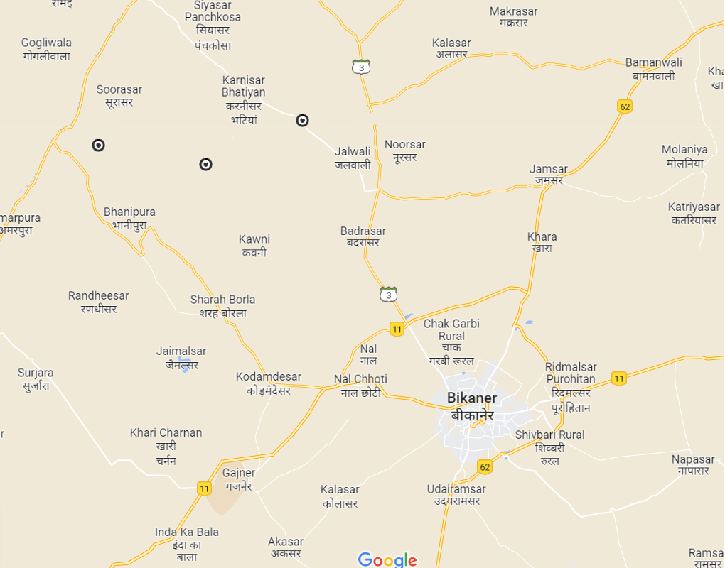
Annexure 11: Location of RVUNL Solar Park
Barala
Ramsar Chhota
Bandrewala
∼ 40 km
Borders shown in the picture are indicative

Slide 72
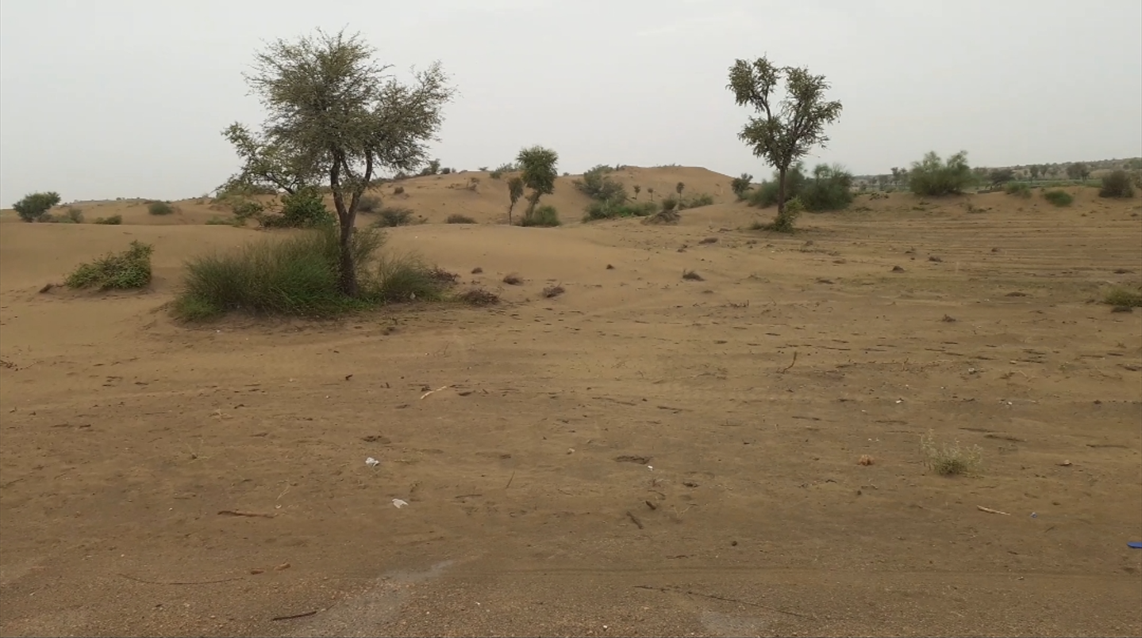
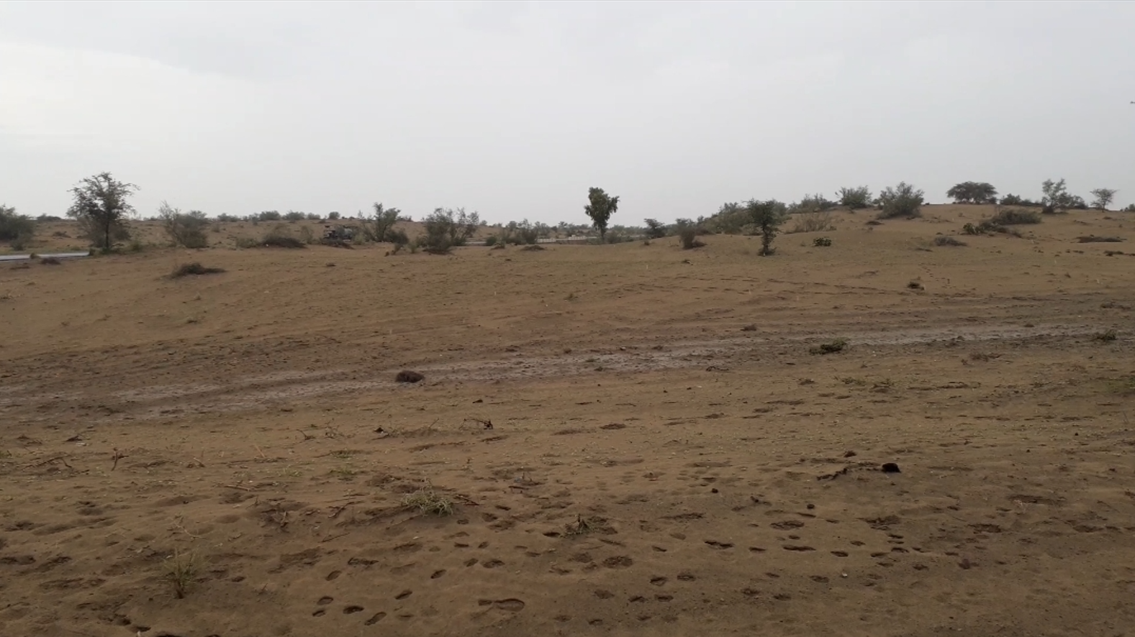
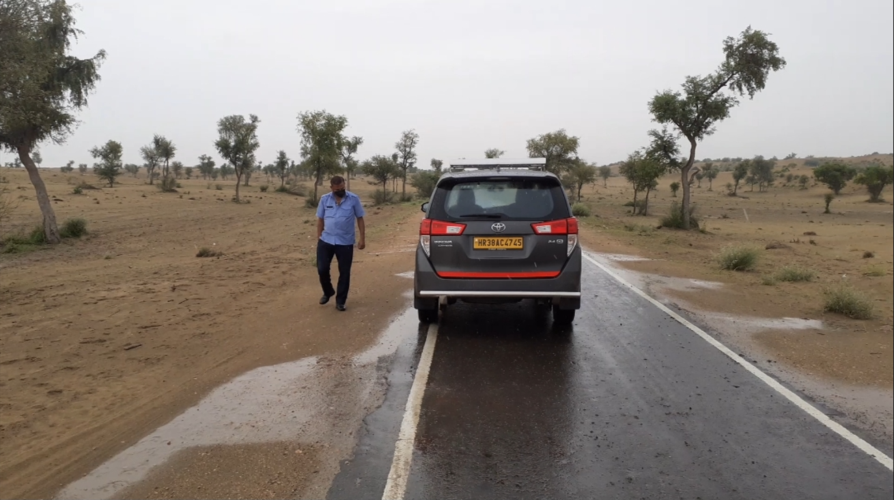
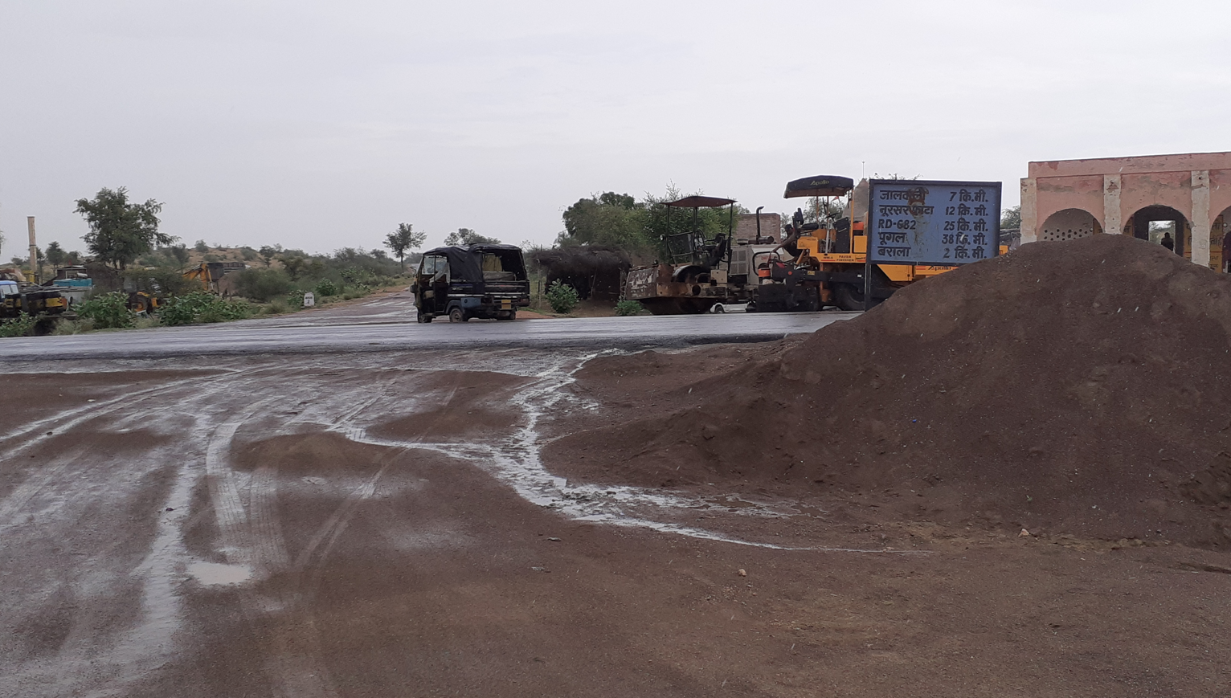
Annexure 12: RVUNL Solar Park – pictures from site visit
SAND DUNES
BARALA SITE
BARALA SITE
SAND DUNES
Land at the solar park is sandy with presence of sand dunes
MAIN ROAD CONNECTING TO BIKANER
BARALA SITE
ROAD CONNECTING THE SITE TO MAIN ROAD

Slide 73
Annexure-13: CPSU Ph-II Scheme
Government of India, through Ministry of New & Renewable Energy (MNRE) has approved the implementation of CPSU Scheme Phase-II for setting up 12,000 MW grid-connected Solar Photovoltaic (PV) Power Projects by CPSUs/ State PSUs/ Government Organizations, with Viability Gap Funding (VGF) support, for self-use or use by Government/ Government entities, either directly or through Distribution Companies (DISCOMS).
12000 MW Grid Connected Solar PV
Only for Government Producers
For Self/ Govt. Entities’ Consumption
Bidding by IREDA based on Viability Gap Funding (VGF)
“a) directly controlled by the Central or State Government or
b) is under the administrative control of Central or State Government or
c) a company in which Government is having more than 50% shareholding.
“a) directly controlled by the Central or State Government or
b) is under the administrative control of Central or State Government or
c) a company in which Government is having more than 50% shareholding.
“a) Maximum Rs. 0.55 Cr /MW, to be decided through bidding
b) VGF will be released in two tranches as follows:
i.50% on Award of contract to the EPC contractor
ii. Balance 50% on successful commissioning of the full capacity of the project
“Indian Renewable Energy Development Agency Limited (IREDA) is the Implementation Agency which will allocate the VGF fund by bidding using bucket filling method”
Rs. 2.45/kWh
Capping for Tariff
30 months
Commissioning Timeline
BACK TO MAIN SLIDE

Slide 74
Annexure-14: Capital Cost Estimations (1/3)
Input Assumptions
Particulars | Unit | Assumption taken | Remarks, if any
Project Size - AC Capacity | MW | 690
Project Size - DC Capacity | MW | 966
Overloading Factor |  | 40%
CUF - first year (at delivery point - based on AC capacity) | % | 28.0%
Annual Degradation of Generation | % | 0.7%
Construction Start Date | Date | 1-Jul-23
Construction period | Years | 1.5
Project COD | Date | 1-Jan-25
Project Life | Years | 25
Cost of Solar Modules (excl. GST) | INR/Wp | 28.50 | As per BAU scenario
Cost of Solar Modules (incl. GST) | INR/Wp | 32.01 | As per BAU scenario
Cost of Balance of System (excl. Land and Evacuation Infra) | INR Cr/MWp | 1.30
Preliminary and Pre-operative Expenses - % of Capital Cost | % | 0.3%
Contingency - % of Capital Cost | % | 1.5%
Upfront Land Allotment Fee | INR Lakh/MW | 3.8
Annual Land Lease Rental (% of upfront allotment fee) | % | 5.5% | Calculated from DPR for 1310 MW (Pg 105-106)
Annual Escalation of Land Lease Rental | % | 5.0% | Applicable second year onwards
Upfront Solar Park Development Charges | INR Lakh/MW | 47.730 | Pg 105 of DPR for 1310 MW
BACK TO MAIN SLIDE

Slide 75
Annexure-14: Capital Cost Estimations (2/3)
Input Assumptions (Contd…)
Particulars | Unit | Assumption taken | Remarks, if any
Solar Park Annual Maintenance Charges | INR Lakh/MW | 2.34 | Pg 106 of DPR for 1310 MW
Annual Escalation of Solar Park Maintenance Charges | % | 5.85% | Input from RVUN/TUV
Water and Miscellaneous Charges | INR Lakh/MW | 0.125 | Avg. of Rs. 10,000/MW and Rs. 15,000/MW (input from RVUN)
Annual Escalation of Water and Miscellaneous Charges | % | 5.85% | Same as escalation rate for Solar park maintenance Charge
Debt to equity ratio |  | 80:20
Average Interest Rate | % | 8% | As per BAU scenario
Loan tenor (door-to-door) | years | 20
Moratorium Period (from COD) | years | 1
Site O&M expenses | INR lakh/mw | 2.50
Site O&M Expenses escalation | % | 3.84%
Insurance | % of proj cost | 0.10%
WC Requirement
Receivables – tariff | Months | 1.5
O&M Expenses | Months | 1
Maintenance spares | of O & M | 15%
WC Interest cost | % | 8.20% | As per BAU scenario
Income tax rate - New Regime / Concessional | % | 25.17%
BACK TO MAIN SLIDE

Slide 76
Annexure-14: Capital Cost Estimations (3/3)
Input Assumptions (Contd…)
Particulars | Unit | Assumption taken | Remarks, if any
Max permissible depreciation | % | 95%
Book Depreciation Rate - SLM
Plant & Machinery | % | 6.33%
Building | % | 3.17%
Tax Depreciation Rate - WDV | % | 40.00%
Solar Capital Cost Drawdown %
Particulars | Unit | FY 2023-24 | FY 2024-25
Plant & Machinery | % | 10% | 90%
Building | % | 40% | 60%
Land Value | % | 100% | 0%
Upfront Solar Park Development Charges | % | 100% | 0%
Preliminary and Pre-operative Expenses | % | 100% | 0%
Contingency | % | 0% | 100%
BACK TO MAIN SLIDE

Slide 77
Annexure 15: Tentative Capex (Turnkey/BOS) inputs from EPC Vendors
 |  | Jakson | Vikram Solar | Tata Power Solar | L&T | Rays Power Infra
Capacity that can be catered by the player | MW | 1000-1200 | 300-500 MW | Can do entire 1.2 GW but would prefer to work with part capacities | Minimum 300 MW and max 600 MW | Can do entire 1.2 GW but would prefer to work with part capacities
Preferable Modality (supply excluding module or including?) |  | Preference is BOS. Would only participate in turnkey post Management approval | Open to both, but would prefer Vikram Solar modules to be utilized | Will only bid for total EPC Turnkey cotract | Open to both | Only BOS
CUF | % | 28% | 28% | 28% | <28% | Will submit quotation numbers post study of RfP
DC Overloading | % | 50% | 40% | 30-45% | 30-50%
Module and BOS Separate:
Landed Module Price (incl GST) | Rs/Wp | 32 | 31.5 | 30 | 30.71
Type of module |  | Fixed Tilt 540-550 Wp | 540 Wp as per ALMM | 540 Wp monoperc | Min 540 Wp with fixed tilt or tracker, whichever would be suitable
Module Price | Rs Cr/MWp | 3.2 | 3.15 | 3 | 3.07
BOS Cost (excl GST) | Rs Cr/MWp | 1.3 | 1.5 | N.A | 1.8
GST on BOS | % | 13.80% | 13.80% | N.A | 13.80%
BOS Cost incl of GST | Rs Cr/MWp | 1.48 | 1.71 | N.A | 1.99
Total EPC Cost per MWp | Rs Cr/MWp | 4.7 | 4.9 | N.A | 5.1
Total EPC Cost per MWAC | Rs Cr/MWAC | 7.0 | 6.8 | N.A | 7.1
Turnkey:
Total EPC Cost per MWp (excl GST) | Rs Cr/MWp | 5.4 | 4.3 | 3.8 | 5.0
GST | % | 13.80% | 13.80% | 13.80% | 13.80%
Total EPC Cost per MWp (incl GST) | Rs Cr/MWp | 6.1 | 4.9 | 4.4 | 5.7
Total EPC Cost per MWAC (incl GST) | Rs Cr/MWAC | 9.2 | 6.8 | 6.0 | 8.0
Scope for price optimization | % | 3% to 5% | Can be determined post site visit and RfP study | Can be determined post site visit and RfP study | Can be determined post site visit and RfP study
Addl. remarks if any |  |  | Last bid by Vikram Solar for 2.2 Cr/MWAC BOS (incl. GST) - @18% GST. For BOS, they apply 18% GST as per their legal team |  | Overloading of 20-30% for tracker and 50% for fixed tilt
BACK TO MAIN SLIDE

Slide 78
Annexure 16: Salient points of discussion with M/s Sova Solar on 06.12.2022 (1/2)
Current manufacturing facility:
Product: Solar PV Modules Location of manufacturing facility: Durgapur, West Bengal Current manufacturing capacity: Solar module manufacturing @950 MW/annum Technical particulars of Solar modules: Mono PERC Half-cut (540-550 Wp) and Bifacial (650-660 Wp) modules; Cell size: 182mmx182mm; Module Size: 2.2mx1.1m TOPCon and HJT modules are in R&D stage Current throughput: 6000 modules/day
Planned expansion of manufacturing capacity:
Plan to reach a capacity of 1.2 GW/annum by Mar 2023 and 2 GW/annum by Dec 2024
Options for procurement of solar modules:
Module supply by Sova Solar under rate contract: Validity of rates of solar modules will be for maximum 3 months, since the module prices are volatile Time: Lead time taken by Sova Solar would be around 2 months Current market price of domestic Solar modules: (prices of Mono-PERC Half-cut modules): Modules of Adani, Tata, Vikram: ∼Rs. 30/Wp Modules of Sova Solar: ∼Rs. 29.25/Wp (for bifacial modules, price will be ∼Rs. 30/Wp) Quantity of modules that can be supplied by Sova Solar: Orders are booked till 15th / 16th Feb 2023 Sova Solar can commit supply of 25-30 MW modules by March 2023 After expansion of capacity to 1.2 GW, Sova Solar can supply 65-70 MW modules
BACK TO MAIN SLIDE

Slide 79
Annexure 16: Salient points of discussion with M/s Sova Solar on 06.12.2022 (2/2)
Options for procurement of solar modules: (contd. From previous slide)
Module supply by Sova Solar under Tolling arrangement: Materials to be supplied by CIL: Major items that are to be imported (e.g., Solar Cells, Solar Glass) are to be supplied by CIL. For Cell purchase, Sova Solar and CIL can jointly negotiate with the Cell suppliers. ∼ Validity of rates of solar modules will be for maximum 3 months, since the module prices are volatile Time: Once CIL supplies the raw materials, Sova Solar will take 7 days to supply the modules considering 10 MW lot size Opportunity for cost optimization: ∼10-12% cost optimization is possible on Cell price NTPC is also planning for the tolling model – tie-up arrangement with 3 module suppliers (each for different regions, e.g., northern, eastern, southern region)
Next Steps
Sova Solar will share the following: Its company profile and details of solar modules Broad-level numbers / competition for savings under the tolling model A visit to the manufacturing facility of Sova Solar will be planned for the first week of January
BACK TO MAIN SLIDE

Slide 80
Deloitte refers to one or more of Deloitte Touche Tohmatsu Limited, a UK private company limited by guarantee (“DTTL”), its network of member firms, and their related entities. DTTL and each of its member firms are legally separate and independent entities. DTTL (also referred to as “Deloitte Global”) does not provide services to clients. Please see www.deloitte.com/about for a more detailed description of DTTL and its member firms.
This material has been prepared by Deloitte Touche Tohmatsu India LLP (“DTTI LLP”), a member of Deloitte Touche Tohmatsu Limited, on a specific request from you and contains proprietary and confidential information. This material may contain information sourced from publicly available information or other third party sources. DTTI LLP does not independently verify any such sources and is not responsible for any loss whatsoever caused due to reliance placed on information sourced from such sources. The information contained in this material is intended solely for you. Any disclosure, copying or further distribution of this material or its contents is strictly prohibited.
Nothing in this material creates any contractual relationship between DTT ILLP and you. Any mutually binding legal obligations or rights may only be created between you and DTTI LLP upon execution of a legally binding contract. By using this material and any information contained in it, the user accepts this entire notice and terms of use.
©2022 Deloitte Touche Tohmatsu India LLP. Member of Deloitte Touche Tohmatsu Limited
Deloitte Touche Tohmatsu India Private Limited (U74140MH199 5PTC093339), a private company limited by shares, was converted into Deloitte Touche Tohmatsu India LLP, a limited liability partnership (LLP Identification No. AAE-8458),with effect from October 1, 2015.

